Slide 1
CSSE 332 Inter-Process Communication

Slide 2
Outline
How processes communicate with each other?
Share Memory
Message Passing

Slide 3
Why processes need to communicate
Normally processes are intentionally isolated from each other
But sometimes they need to communicate (e.g. if a process starts another to work a job, it might need to know the progress of the job etc.)
They can use an external thing like the filesystem – but that tends to have other side effects (e.g. disk space, directory permissions, etc.)
As the thing that creates the isolation, OS gets to decide how IPC works

Slide 4
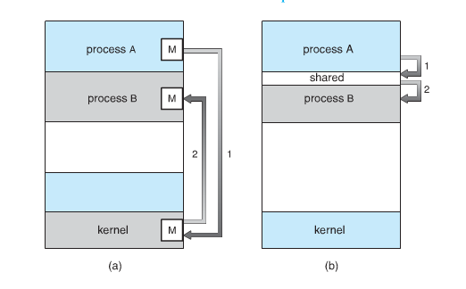
IPC mechanism
Shared memory
Message passing

Slide 5
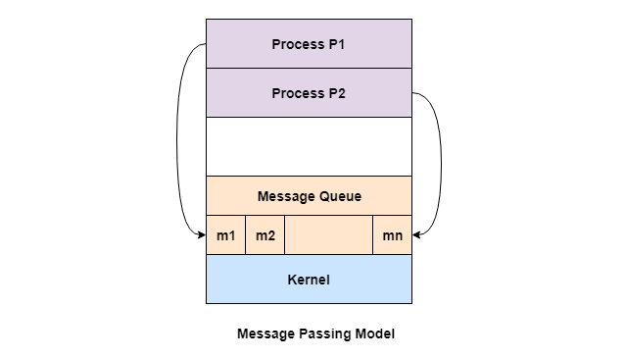
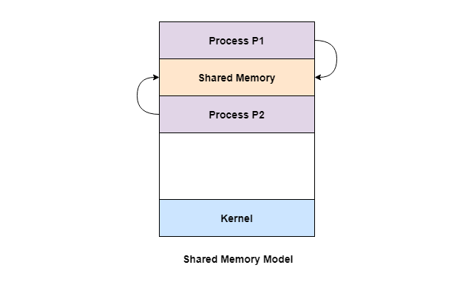
Similarity
Both write/read things on memory
BUT it's usually quite nice to have the OS manage things

Slide 6
Difference
Shared memory
Quick and efficient
Easy to mess up due to concurrency issues
Message Passing
Overhead to construct a message and manage the queue
More reliable with more processes.

Slide 7
Shared Memory
Establish a region of shared memory
Both processes can read or write data in shared memory region
OS has no control over this memory

Slide 8
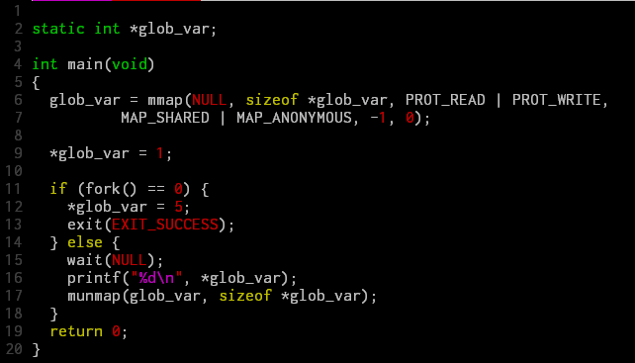
Shared memory: mmap

Slide 9
Share memory: activity
Finish factoring_shared.c using share memory.

Slide 10
Message Passing
Allows processes to communicate and to synchronize their activities without having to share the same address space
It requires certain communication link, e.g.,
Share memory
Network
Methods: socket, pipe, etc.
Notes:
A message passing facility provides at least two operations (primitives): send and receive
The send and receive primitives are system calls because the message passing facility is provided by the OS
Send: sends a message to a given destination
Receive: receives a message from a given source or from ANY source if the receiver does not care.
If no message is available the receiver can block until one arrives.
Messages can have fixed sizes or variable sizes.
10

Slide 11
Addressing
Direct address
Indirect address
Send to a queue (i.e., mailbox)
send (destination, message)
receive (source, message)

Slide 12
Synchronization
Synchronous
Block – wait until message delivered.
Asynchronous
Non-block – no wait.
Buffered
Unbuffered

Slide 13
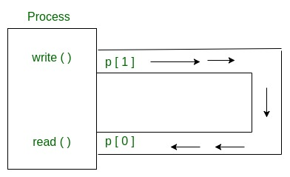
Message Passing: pipe
int pipe(int fds[2]);
Parameters :
fd[0] will be the fd(file descriptor) for the read end of pipe.
fd[1] will be the fd for the write end of pipe. Returns : 0 on Success. -1 on error.

Slide 14
Message passing activity
Check the example code in pipes_example.c, then use pipes to redo factoring_pipes.c

